Slide 1
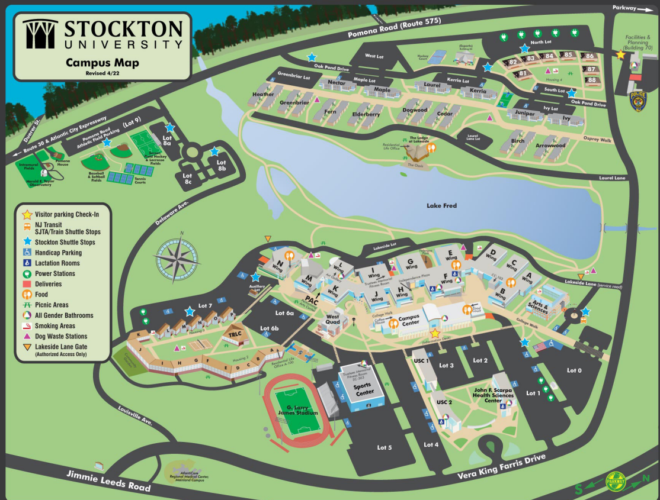
PARK →
Meeting →

