Slide 1
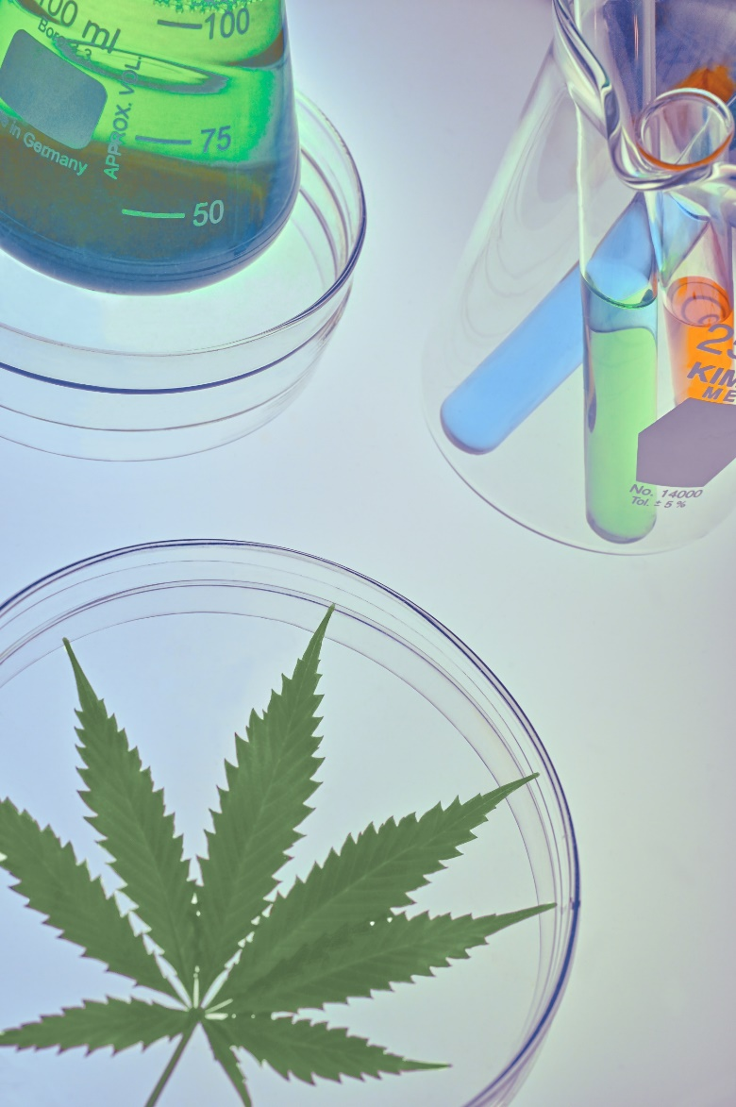
Cannabis Concentration
and Health Risks
The Role of Potency in Cannabis Use Outcomes
A joint report from the University of Washington
and Washington State University Workgroup
for the Prevention and Research Sub Committee (PRSC)
October 2020
Notes:
Note to User: This slide deck is based on a report prepared for the PRSC on the health risks of using high potency cannabis. This slide deck is in the public domain and may be used for education without special permission. However, any content should be attributed to the PRSC Cannabis Concentration Workgroup. This product may be used for educational purposes only. Note, all graphics in this presentation were obtained from public sources.
Publication Date: October 2020

Slide 2
Cannabis Concentration Workgroup
Prevention Research Sub Committee (PRSC)
Main Goal:
Consensus Statement on Health Risks of Non-Medical Use of High Potency (High THC-Concentration) Cannabis
Is high potency cannabis more detrimental to health than lower potency cannabis?
Are marginalized and/or vulnerable populations disproportionally affected by high potency cannabis use?
Notes:
In a time of legalized retail cannabis sales, one question keeps getting raised….is use of high potency cannabis (cannabis with a high concentration of THC) safe for the citizens of Washington State?
The WA State Health Care Authority’s Division of Behavioral Health and Recovery has a scientific advisory group, the Prevention Research Sub Committee. In March 2020, the sub-committee invited a work group of researchers to better understand the scientific evidence of the health and behavioral risks of non-medical high potency cannabis use. The intent of the workgroup was to help inform policy and practice with the best science available.
The workgroup was organized and chaired by Dr. Bia Carlini at the UW Alcohol and Drug Abuse Institute. Dr. Carlini invited scientists in the field to present the evidence to each other, with the assistance of community-based organizations, in order to come to a consensus about 1) whether high potency cannabis is more detrimental to health than low potency cannabis, and 2) which populations are most likely to be affected by high potency cannabis use.

Slide 3
The content expressed herein do not reflect the official position of the Division of Behavioral Health and Recovery at the WA State Health Care Authority. No official support or endorsement for the opinions described in this document is intended or should be inferred. The focus is on THC content and non-medical use.
DISCLAIMER
Notes:
The content expressed herein do not reflect the official position of the Division of Behavioral Health and Recovery at the WA State Health Care Authority. No official support or endorsement for the opinions described in this document is intended or should be inferred. The focus is on THC content and non-medical use.

Slide 4
Agenda
Why Concentration Matters
Research Context
Health Risks and Consequences
Who is Most Affected?
Questions and Next Steps
Notes:
In his presentation we’ll discuss current research relevant to the health effects associated with the use of highly concentrated cannabis. Specifically, we’ll discuss:
Why concentration, or potency, matters
The research context in which scientists conduct studies on non-medical drug use
The specific health risks and consequences of high-potency use
Which populations are most likely to bear the burden of these risks
And, finally, the next steps for policy and research

Slide 5
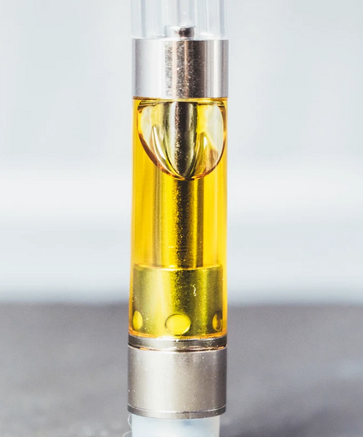
Why Concentration Matters
Notes:
Why does concentration matter?

Slide 6
In a not distant past . . . In a not distant land . . .
Average Potency = 3–8% THC
High Potency > 10% THC
And then market forces redefined cannabis . . .
Notes:
[click] In a not distant past, in a familiar land, cannabis use was mostly synonymous with consuming the cannabis plant. Anti-prohibition movements embraced the color green and the emblematic image of cannabis’ pointy leaves to promote policy change.
[click] Nearly all cannabis had 3-8% THC content.
[click] THC content of more than 10% was considered high-potency cannabis.
[click] Fast forward to 2020 and cannabis cultivation, processing, and sales are run by for-profit enterprises in many US states.

Slide 7
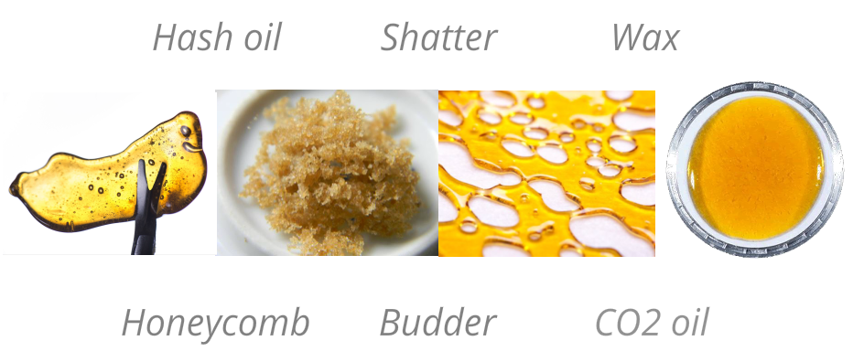
Why Concentration Matters
Manufactured products have THC concentrations of 60-90%
Notes:
Cannabis now lives in the world of business where product development and marketing are essential for survival. Cannabis as we knew it has changed. Processing, extraction, concentration, and the addition of new ingredients have become common. Highly potent manufactured cannabis products are available in retail stores, with THC content varying from 60-90%. They don’t resemble the plant – they are as close to the cannabis plant as strawberries are to frosted strawberry pop tarts.

Slide 8
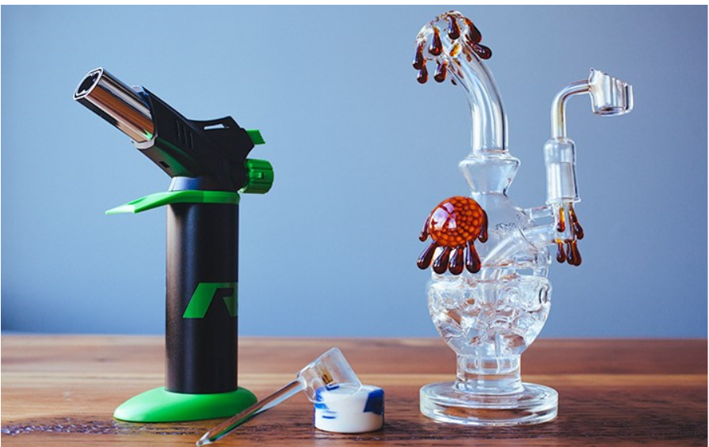
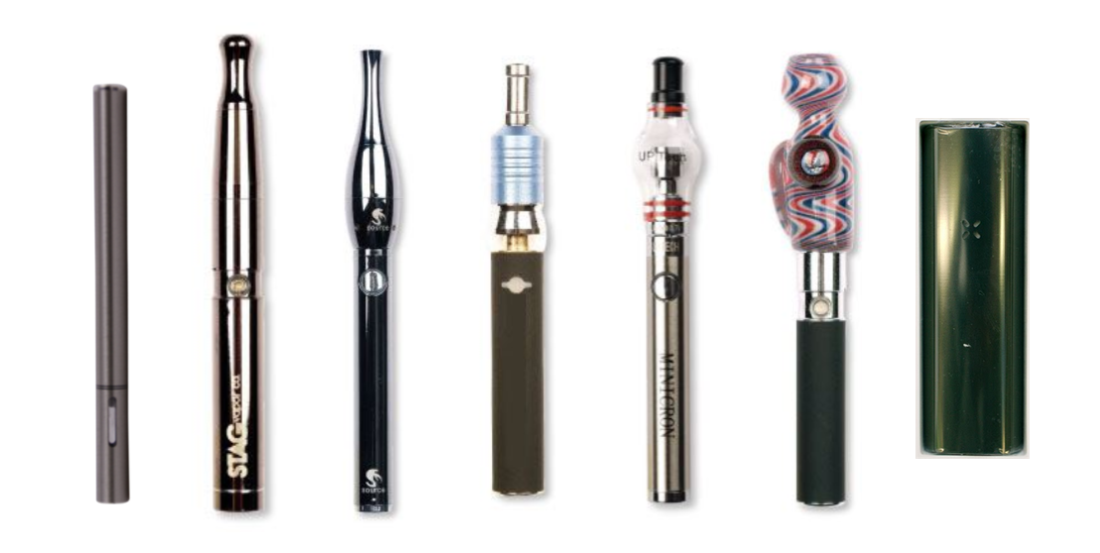
Why Concentration Matters
Delivery devices have changed
Vaping
Dabbing
Notes:
Potency of cannabis is typically defined by the amount of THC within cannabis products, with varying cut-offs; and more recently by mode of cannabis administration.
High THC manufactured products such as cannabis concentrates (wax, shatter), and liquid extracts are used in vaping devices, dabbing, and infused edibles (candy or cookies).
Dabbing is usually considered to be riskier than vaping, in that one hit delivers a very high amount of THC, and users are unable to effectively titrate their dose.¹
¹Sagar KA, Lambros AM, Dahlgren MK, Smith RT, Gruber SA. Made from concentrate? A national web survey assessing dab use in the United States. Drug Alcohol Depend. 2018;190:133-142. doi:10.1016/j.drugalcdep.2018.05.022

Slide 9
Why Concentration Matters
Sales of cannabis concentrates are increasing in WA
A nearly ten-fold increase in sales from extracts
(from $3.95 million in 2014 to $311 million in 2017).
Legalization = Mass production
Why?
Extracts are Cheaper and Shelf-Stable
Kilmer, Beau, Steven Davenport, Rosanna Smart, Jonathan P. Caulkins, and Gregory Midgette, After the Grand Opening: Assessing Cannabis Supply and Demand in Washington State. Santa Monica, CA: RAND Corporation, 2019. https://www.rand.org/pubs/research_reports/RR3138.html.
Firth CL, Davenport S, Smart R, Dilley JA. How high: Differences in the developments of cannabis markets in two legalized states. Int J Drug Policy. doi:10.1016/j.drugpo.2019.102611
WA State House Commerce and Gaming Commission work session. Sep 15, 2020. https://www.tvw.org/watch/?eventID=2020091004
Notes:
Manufactured cannabis extracts now represent 35% of the WA cannabis market², up from 9% in 2014¹.
[click] This represents a nearly 10-fold increase in sales from extracts, [click] from $3.95 million in 2014 to $311 million in 2017.
[click] Why is this the case? Primarily because extracts are cheaper and shelf-stable.
¹Kilmer, Beau, Steven Davenport, Rosanna Smart, Jonathan P. Caulkins, and Gregory Midgette, After the Grand Opening: Assessing Cannabis Supply and Demand in Washington State. Santa Monica, CA: RAND Corporation, 2019. https://www.rand.org/pubs/research_reports/RR3138.html.

Slide 10
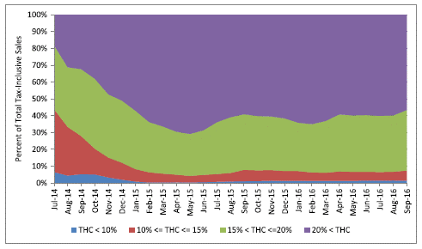
Why Concentration Matters
Flower with less than 10% THC has vanished from the WA market
Smart R, Caulkins JP, Kilmer B, Davenport S, Midgette G. Variation in cannabis potency and prices in a newly legal market: evidence from 30 million cannabis sales in Washington state.
Addiction. 2017;112(12):2167-2177.
Notes:
In WA State, product development has meant the near disappearance of cannabis with less than 10% THC. Twenty percent THC and over has become the new normal.
¹Smart R, Caulkins JP, Kilmer B, Davenport S, Midgette G. Variation in cannabis potency and prices in a newly legal market: evidence from 30 million cannabis sales in Washington State. Addiction. 2017;112(12):2167-2177.

Slide 11
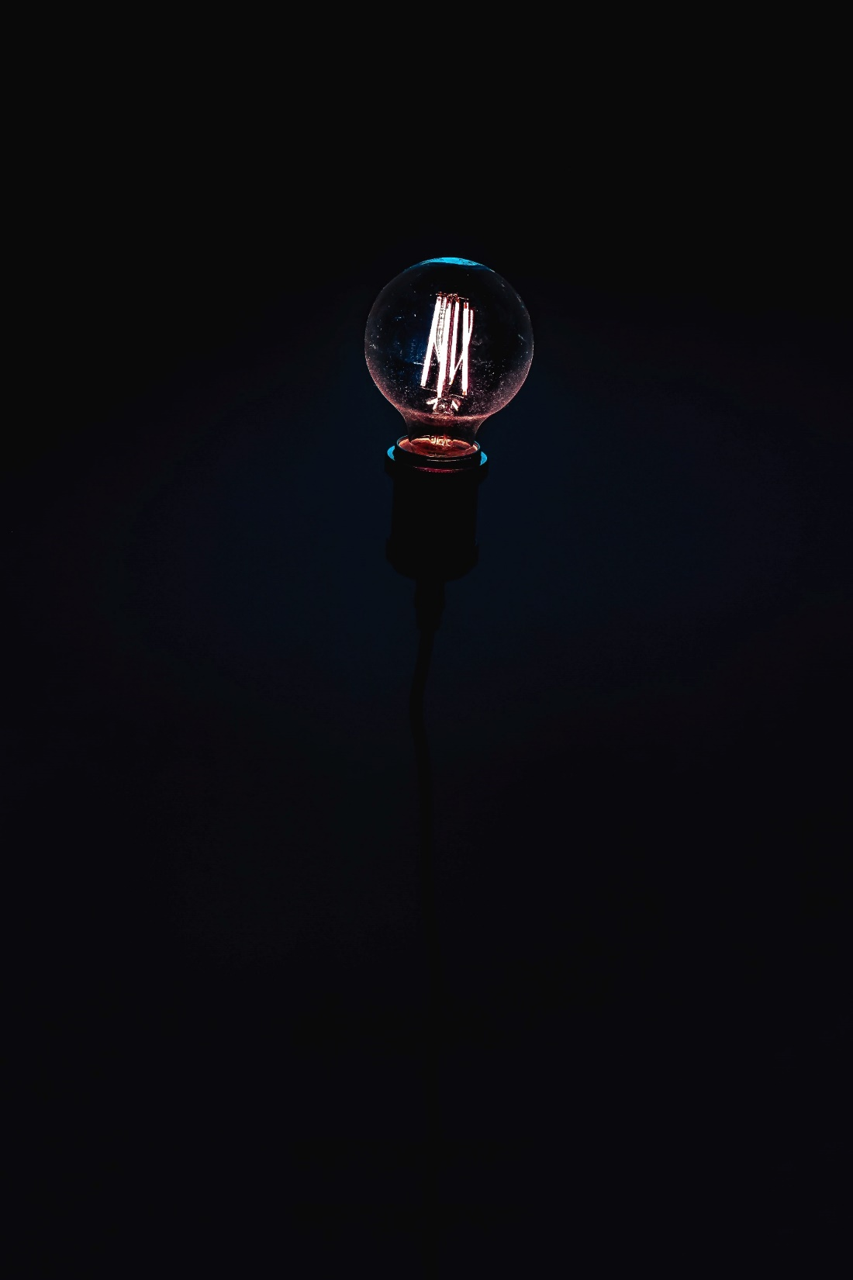
Research Context
Notes:
It is helpful to understand the range of studies examined, how they were conducted, and the challenges in drawing broad conclusions. While more research is needed and the research to date contains some inherent limitations, evidence exists to make some well-supported assertions.

Slide 12
Research Context
Challenges exist:
Federally, Cannabis is a Schedule I Drug
This limits the ability of researchers to control the product, as they might when investigating dose for a pharmaceutical
Randomized Controlled Trials are Unethical
Researchers can’t randomize people to a condition that may cause harm, like taking high-potency cannabis
Cannabis Products Used in the Real World are Difficult to Measure
Variations exist in product type, routes of use, frequency of use, and even individual patterns of use (e.g. depth of inhalations)
Notes:
[click] Because cannabis is prohibited at the federal level, researchers struggle to gain access to cannabis products that are similar to those found in legal markets.
[click] Even if these products were available, standard randomized controlled trials would not likely be conducted. While the gold standard of research is the Randomized Controlled Trial (RCT), in which study participants are randomized to receive an exposure or not, in this case to high potency cannabis, RCTs are not always possible or ethical to conduct in humans. Research on non-medical use of cannabis, opioids, tobacco, and alcohol consumption must rely on alternative study designs and use sophisticated statistical methods to mimic RCTs in order to draw conclusions.
[click] Finally, unlike research on alcohol, which utilizes percent alcohol (proof) as a measure of potency, cannabis studies lack a consistent definition of what high potency cannabis products include. Potency of cannabis is typically defined by the amount of THC within cannabis products, with varying cut-offs; and more recently by mode of cannabis administration of high-THC manufactured products, such as cannabis concentrates (wax, shatter), and liquid extracts used in vaping devices and infused edibles (candy or cookies).

Slide 13
Research Context
Many strong research designs inform policy:
Observational Studies of People with Different Behaviors or Conditions
People with a particular health outcome or pattern of cannabis use are chosen and retrospectively or prospectively observed
Surveys and Secondary Analysis
People report cannabis use patterns, health behaviors, and health outcomes. Statistical methods can model these data.
Animal Studies
Randomization to high potency cannabis CAN occur in animals
These are the same designs and approaches that guide policy decisions
for ALL substances used non-medically
Notes:
Evidence-based drug policy decisions have often been informed by proven methodologies other than RCTs.
[click] In this review, contributors selected rigorously designed human studies that recruited people with a particular health outcome and compared their use of cannabis to use among similar participants without that same health outcome. OR, they found people with a particular pattern of use, and observed their health outcomes compared to others with a different pattern of use.
[click] They also relied on surveys and secondary data analysis, where people reported their cannabis use patterns, health behaviors, and health outcomes.
[click] . . . As well as good quality animal studies in which randomization CAN occur.
[click] These are the same designs and approaches that guide clinical and policy decisions for other substances, when used for non-medical purposes.

Slide 14
Research Context
Industry representatives use these challenges to:
Minimize research findings
Criticizing research designs
Misinterpret data
Confuse medical use with non-medical use
Make potency sound more complicated than it is
WA State House Commerce and Gaming Commission work session. Sep 15, 2020. https://www.tvw.org/watch/?eventID=2020091004
Notes:
Industry lobbyists have used the fact that RCTs have not typically been conducted to minimize research findings and criticize research designs. This has led to a misinterpretation of some data to suit their agenda.
In addition, there has been a tendency to confuse the needs and rights of medicinal cannabis users with non-medical use.
Finally, while measuring potency has its challenges, industry representatives have tried to paint it as so complicated that relationships can never be teased out. This is not the case, and in fact many types research methods have always been used to inform policy decisions.
WA State House Commerce and Gaming Commission work session. Sep 15, 2020. https://www.tvw.org/watch/?eventID=2020091004
case, and even with challenges, this group of scientists was able to come to a consensus about what is known to date.

Slide 15
Research Context
Defining “high-potency”
Not all studies use the same definition.
This report included studies that:
Examined a dose-response relationship between THC content and health outcomes
or
Recorded adverse events associated with consuming highly concentrated manufactured products
Notes:
As mentioned earlier, the definition of “high-potency” cannabis is not universal across studies. For this report, the workgroup synthesized the evidence on studies that a) examined the dose-response relationship between THC content and health outcomes or b) reported adverse events associated with consuming highly concentrated manufactured products.

Slide 16
Health Risks and Consequences
Spoiler:
High potency cannabis is more detrimental to health than lower potency cannabis
Notes:
Select workgroup members were tasks with collecting and synthesizing the research on specific health outcomes of interest, including how high-potency cannabis us affects adolescents, pregnancy, driving, and more.
Spoiler: high potency cannabis is more detrimental to health than lower potency cannabis.
Next, we’ll focus on each of these areas of interest.

Slide 17
Health Risks and Consequences
Cannabis Concentration and Poison Center Calls
Review by Julia Dilley, PhD
Dilley JA, Brooks-Russell A, Whitehill JM, Graves JM – Manuscript in preparation
Notes:
Using information from the National Poison Data System about cannabis exposures reported to U.S. poison centers from January 2017-December 2019, Dilley and colleagues compared trends and characteristics of two groups of cannabis products: plant materials (flower, joints), and relatively higher THC potency manufactured products such as edibles (infused candy or cookies), cannabis concentrates (wax, shatter), and liquid extracts used in vaping devices.
____
Julia A. Dilley, PhD, MES¹, Ashley Brooks-Russell, PhD, MPH², Jennifer M. Whitehill, PhD³, Janessa M. Graves, PhD, MPH⁴. Manuscript in preparation. September 4, 2020.
¹Program Design and Evaluation Services, Multnomah County Health Department and Oregon Public Health Division, Portland, OR; ²Department of Community and Behavioral Health, Colorado School of Public Health, University of Colorado Anschutz Medical Campus, Aurora, CO; ³Department of Health Promotion and Policy, University of Massachusetts Amherst, Amherst, MA; ⁴Washington State University College of Nursing, Spokane, WA

Slide 18
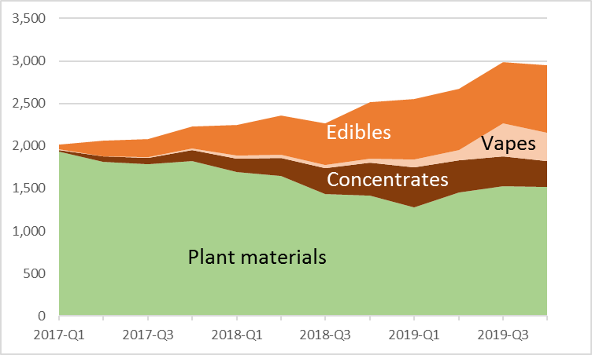
Health Risks and Consequences
High-Potency Cannabis Product Exposures Increased Relative to Plant Materials (US, 2017-2019)
Plant materials:
Majority co-use (61%)
9.8% children 11 or younger
Concentrates, edibles and vapes:
Majority cannabis-only (82%)
29.7% children 11 or younger
Types of exposures reported to poison centers
Notes:
A total of 29,471 cannabis-related exposures were reported during the three-year period. The greatest share was for cannabis plant materials (65.6%) followed by edibles (19.1%), concentrates (9.7%), and vape liquids (3.8%.) As seen in the Figure, case reports over time were relatively stable for plant material exposures. However, manufactured product exposures increased substantially between October-December 2017 and the same quarter in 2019: for edibles (259 to 789), concentrates (from 128 to 307), and vape liquids (15 to 333).
[click] Individuals exposed to manufactured products were more likely to be children ages 11 or younger (29.7% vs. 9.8% of plant materials cases). The majority of plant material cases (61.0%) involved co-use of other substances, (e.g., alcohol), but only 17.9% of manufactured cannabis product cases involved additional substances. Among adults exposed only to cannabis in Oct-Dec 2019, vape liquid exposure cases were more likely to require healthcare treatment (43.6%) than plant material (30.8%), edible (30.1%), and concentrate (27.7%) exposures.

Slide 19
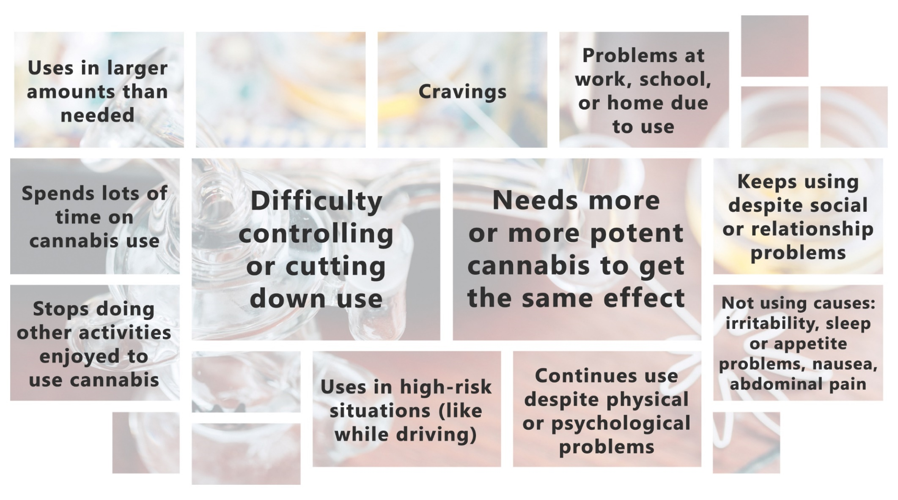
Health Risks and Consequences
Cannabis Concentration and Cannabis Use Disorder (CUD)
Cannabis Use Disorder Symptoms
Review by Denise Walker, PhD & Jason Kilmer, PhD, University of Washington
Notes:
Cannabis addiction, known as Cannabis Use Disorder (CUD), is a condition that impairs social functioning, memory, decision-making, and school/work performance. A small but growing literature suggests that frequent cannabis use and high potency cannabis increase the chances of experiencing CUD,¹⁻⁴ especially in young people who report a “better high” and a more frequent experience of paranoia and memory impairment.⁴
¹Bidwell LC, YorkWilliams SL, Mueller RL, Bryan AD, Hutchison KE. Exploring cannabis concentrates on the legal market: User profiles, product strength, and health-related outcomes. Addictive Behaviors Reports. 2018;8:102-106.
²Curran HV, Hindocha C, Morgan CJA, Shaban N, Das RK, & Freeman TP. Which biological and self-report measure of cannabis use predict cannabis dependency and acute psychotic-like effects? Psychological Medicine. 2019;49:1574-1580.
³Hines LA, Freeman TP, Gage SH, Zammit S, Hickman M, Cannon M, Munafo M, MacLeod J, & Heron J. Association of high-potency cannabis use with mental health and substance use in adolescence. JAMA Psychiatry. 2020;epub ahead of print E1-#8.
⁴Freeman TP, & Winstock AR. Examining the profile of high-potency cannabis and its association with severity of cannabis dependence. Psychological Medicine. 2015;45:3181-3189.

Slide 20
Health Risks and Consequences
Higher potency increases risk of CUD
Takeaway:
Use of cannabis with high THC concentration (or high potency) increases the chances of developing Cannabis Use Disorder (CUD) or addiction to cannabis, particularly among young people.
Context:
These studies have been conducted by observing people over time (prospectively or retrospectively.)
It is not ethical to conduct studies that randomize people to different concentrations of cannabis to ascertain risk of addiction overtime.
Review by Denise Walker, PhD & Jason Kilmer, PhD, University of Washington
Notes:
Barrington et al. (2019) found that for youth experimenting with cannabis, cannabis concentrate use was most strongly associated with progression and persistence of use during a 12-month period than for other cannabis products.¹ Although this study did not evaluate CUD symptoms specifically, it does suggest potency can be a contributing factor to youth experimental use transitioning to more regular use.
A study in the U.S. tracked THC potency and CUD symptom onset² and found that “higher potency cannabis, on average in the U.S., used at cannabis initiation was associated with over four times the risk of CUD symptom onset within the first year of initiation, as compared to those not endorsing symptom onset.” With college students, those who frequently used high potency products reported a higher risk of cannabis dependence, measured by a scientifically validated instrument, CUDIT-R.³
Takeaway:
Use of cannabis with high THC concentration (or high potency) increases the chances of developing Cannabis Use Disorder (CUD) or addiction to cannabis, particularly among young people.
As we discussed earlier, these studies were observational in nature, and looked at risk of developing CUD over time.
References
Barrington, Trimis, J.L., Cho, J., Ewusi-Boisvert, E., Hasin, D., Unger, J.B., Miech, R.A., & Leventhal, A.M. (2020). Risk of perstistence and progresttion of use of 5 cannabis products after experimentation among adolescents. JAMA Network Open, 3(1):e1919792. Doi:10.1001/jamanetworkopen.2019.19792
Atterberry, B.J., Treloar Padovano, H., Foster, K.T., Zucker, R.A., & Hicks, B.M. (2019). Higher average potency across the United States is associated with progression to first cannabis use disorder symptom. Drug and Alcohol Dependence, 195, 186-192.
Gunn, R.L., Aston, E.R., Sokolovsky, A.W., White, H.R., & Jackson, K.M. (2020). Complex cannabis use patterns: Associations with cannabis consequences and cannabis use disorder symptomatology. Addictive Behaviors, 105, epub ahead of print.

Slide 21
Health Risks and Consequences
Cannabis Concentration and Psychotic Disorders
Review by Michael McDonell, PhD, Washington State University
Notes:
Psychotic disorders are mental disorders that cause abnormal thinking and perceptions. Two of the main symptoms are delusions and hallucinations.
U.S. National Library of Medicine. Psychotic Disorders. National Institute on Health. https://medlineplus.gov/psychoticdisorders.html. Retrieved September 3, 2020.

Slide 22
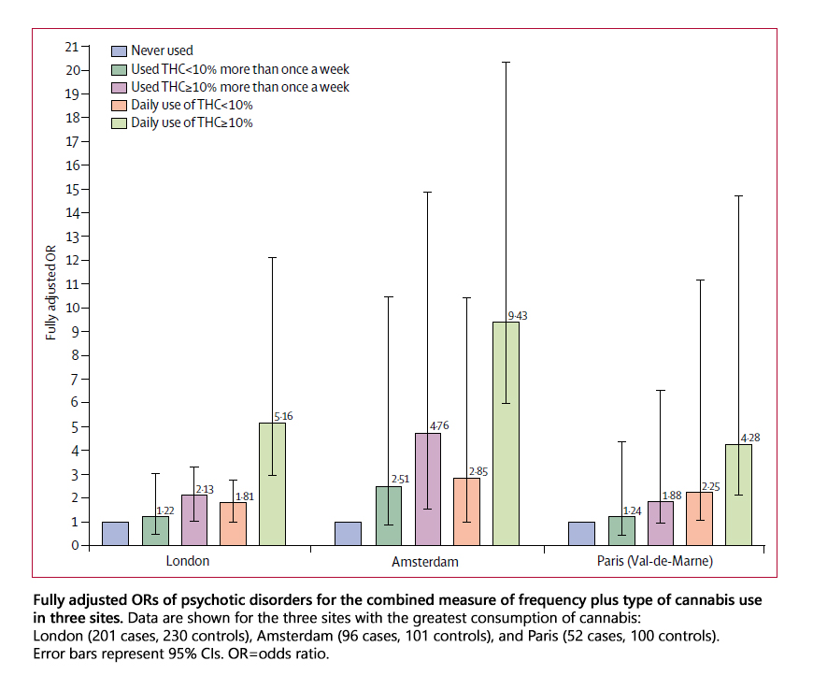
Health Risks and Consequences
Odds of Psychotic Disorder
Di Forti M, et al. The contribution of cannabis use to variation in the incidence of psychotic disorder across Europe (EU-GEI): a multicentre case-control study. The Lancet Psychiatry. 2019;6:427–436.
Notes:
One of the best studies conducted on cannabis and psychosis included 901 patients aged 18–64 years in 11 sites across Europe and Brazil who had recently experienced their first episode of psychosis.⁴ These patients were matched with 1237 similar people (that is, matched by age, race, and socio-economic-status) who did not have psychosis. This is known as case-control study and is a rigorous way to assess whether two things are associated. The study divided the types of cannabis used by participants into two categories: low potency (THC <10%) and high potency (THC ≥10%), based on the products most common in their city. They found that daily cannabis users had three-fold increase in the risk of having a psychotic disorder compared with never users. Those who used high potency cannabis daily were five-times more likely to have a psychotic disorder than never users. Use of high potency cannabis was a strong predictor of psychotic disorder in cities where high potency cannabis was widely available. They concluded that “differences in frequency of daily cannabis use and in use of high-potency cannabis contributed to the striking variation in the incidence of psychotic disorder across the 11 studied sites.”

Slide 23
Health Risks and Consequences
Frequent use of high potency increases risk of a psychotic disorder
Take Away:
Daily cannabis use, particularly of high potency products, increases the risk of developing a psychotic disorder, like schizophrenia, AND earlier onset of symptoms compared to cannabis abstention.
Daily use of cannabis, particularly high potency cannabis, is associated with increased symptoms of psychosis in people who have a psychotic disorder.
Context:
Studies on this topic define high potency cannabis as products with 10% or more THC.
There are no published studies investigating the association between products available in US legal market (60%-90% THC) and the onset of first episode psychosis or on increases of symptoms of in those who have a psychotic disorder.
Review by Michael McDonell, PhD, Washington State University
Notes:
A 2020 review of 56 good quality studies¹ on cannabis and psychosis concluded that frequent cannabis use, especially daily use, and the consumption of high-potency cannabis increase the risk of developing psychosis.² It also shows that cannabis use is associated with an earlier onset of psychosis and increased risk of transition in individuals at a clinical high risk of psychosis. Daily high-potency cannabis use during adolescence is also associated with an earlier onset of psychotic symptoms (6 years earlier) than non-cannabis users.³
One caveat is that these studies defined cannabis as >10% THC. There are no studies evaluating effects on psychosis of high-potency manufactured products currently found in the WA state market.
References:
¹Van der Steur SJ, Batalla A, Bossong MG. Factors Moderating the Association Between Cannabis Use and Psychosis Risk: A Systematic Review. Brain Sci. 2020;10(2):97. Published 2020 Feb 12. doi:10.3390/brainsci10020097.
²Di Forti, M. et al. Daily use, especially of high-potency cannabis, drives the earlier onset of psychosis in cannabis users. Schizophr Bull. 2014;40:1509–1517.
³Di Forti M, et al. The contribution of cannabis use to variation in the incidence of psychotic disorder across Europe (EU-GEI): a multicentre case-control study. The Lancet Psychiatry. 2019;6:427–436.

Slide 24
Health Risks and Consequences
Cannabis Concentration and Adolescence
Review by Nephi Stella, PhD, University of Washington
Notes:
Adolescence is a critical developmental stage when the functional connectivity of the brain and its role in higher cognitive functions are both defined and delineated. This “critical period” of brain development exhibits increased vulnerability to drug exposure, including THC exposure.

Slide 25
Health Risks and Consequences
Dose-response relationship
Negative impact of cannabis use during adolescence
Take Away:
Strong evidence exists on the detrimental impact of THC use during adolescence.
This impact can be modeled in adolescent rodents, providing an opportunity to study the response of the developing brain and explore treatment approaches.
Available evidence suggests a dose-response relationship, where negative impacts are higher with highly potent THC and/or more frequent use.
Context:
Human studies suggest that limiting the availability of high-potency cannabis may reduce the number of individuals who develop CUD and the risk of mental health disorders.
Review by Nephi Stella, PhD, University of Washington
Notes:
A review of the literature on the impact of THC exposure and potency on adolescent brain development and identified 25 publications that addressed this question and were published in academic peer-reviewed journals from 2010 and later. Strong evidence exists that there is a detrimental impact of THC use during adolescence. Studies on the impact of cannabis use on human adolescent brain development focused primarily on three areas: 1) cognitive aptitude and behavior, 2) disruption of brain anatomy and connectivity, 3) disruption in motivated behavior and dopamine function.
Studies with rodents have demonstrated a dose-response relationship, with impacts on motivation/reward behaviors, and increased repetitive and compulsive-like behaviors.
References:
1. Gobbi G, Atkin T, Zytynski T, Wang S, Askari S, Boruff J, . . . Mayo . Association of cannabis use in adolescence and risk of depression, anxiety, and suicidality in young adulthood: a systematic review and meta-analysis. JAMA psychiatry. 2019;76(4):426-434.
2. Hines LA, Freeman TP, Gage SH, Zammit S, Hickman M, Cannon M, . . . Heron J. Association of high-potency cannabis use with mental health and substance use in adolescence. JAMA psychiatry. 2020.
3. Kelly BC & Vuolo M. Cognitive aptitude, peers, and trajectories of marijuana use from adolescence through young adulthood. PloS one. 2019;14(10):e0223152.
4. Orr C, Spechler P, Cao Z, Albaugh M, Chaarani B, Mackey S, . . . Garavan H. Grey matter volume differences associated with extremely low levels of cannabis use in adolescence. Journal of Neuroscience. 2019;39(10):1817-1827.
5. Camchong J, Lim KO, & Kumra S. Adverse effects of cannabis on adolescent brain development: a longitudinal study. Cerebral cortex. 2017;27(3):1922-1930.
6. Gilman JM, Kuster J.K, Lee S, Lee MJ, Kim BW, Makris N, . . . Breiter HC. Cannabis use is quantitatively associated with nucleus accumbens and amygdala abnormalities in young adult recreational users. Journal of Neuroscience. 2014;34(16):5529-5538.
7. Van de Giessen E, Weinstein JJ, Cassidy CM, Haney M, Dong Z, Ghazzaoui R, . . . Abi-Dargham A. Deficits in striatal dopamine release in cannabis dependence. Molecular psychiatry. 2017;22(1):68-75.
8. Kruse LC, Cao JK, Viray K, Stella N, & Clark JJ. Voluntary oral consumption of Δ9-tetrahydrocannabinol by adolescent rats impairs reward-predictive cue behaviors in adulthood. Neuropsychopharmacology. 2019;44(8):1406-1414.
9. Murphy M, Mills S, Winstone J, Leishman E, Wager-Miller J, Bradshaw H, & Mackie K. Chronic adolescent Δ9-tetrahydrocannabinol treatment of male mice leads to long-term cognitive and behavioral dysfunction, which are prevented by concurrent cannabidiol treatment. Cannabis and cannabinoid research. 2017;2(1):235-246.
10. Renard J, Rosen LG, Loureiro M, De Oliveira C, Schmid S, Rushlow WJ, & Laviolette SR. Adolescent cannabinoid exposure induces a persistent sub-cortical hyper-dopaminergic state and associated molecular adaptations in the prefrontal cortex. Cerebral Cortex. 2016;27(2):1297.
11. Renard J, Szkudlarek HJ, Kramar CP, Jobson CEL, Moura K, Rushlow WJ, & Laviolette SR. Adolescent THC exposure causes enduring prefrontal cortical disruption of GABAergic inhibition and dysregulation of sub-cortical dopamine function. Scientific reports. 2017;7(1):11420-14.

Slide 26
Health Risks and Consequences
Other important findings
Titration: Humans and animals can self-titrate their use of cannabis products, adjusting their intake to compensate for potency. The human study reported above was conducted with adult regular cannabis users and cannot be generalized for people under 21 and non-regular users.
Review by Carrie Cuttler, PhD, Washington State University
Driving: Research supports a link between cannabis consumption and driving impairment.
Driving and Potency: No consensus exists on THC concentration and impairment.
Review by Dale Willits, PhD, Washington State University
Pregnancy: Cannabis use is associated with negative health impacts for infants.
Pregnancy and potency: No evidence from human studies to determine THC potency association with poor health outcome among infants.
Review by Celestina Barbosa-Leiker, PhD, Washington State University
Notes:
Other areas that were researched include:
[click] Titration: The Health and Cognition lab at Washington State University (WSU) conducted observational research to examine the acute effects of high-potency cannabis products sold in Washington state retail stores. The results from this research indicate that regular cannabis users self-titrate their use of extremely high-potency cannabis concentrates. Specifically, Cuttler et al. found that the average number of puffs/hits inhaled by participants smoking cannabis flower (with a mean THC concentration of 22.8%) was 17.65, while the average number of puffs/hits taken by participants vaping a cannabis concentrate (with a mean THC concentration of 71.4%) was 9.45.
[click] Driving: While research supports a link between cannabis consumption and driving impairment, no consensus exists on THC concentration levels and impairment. This lack of consensus is likely advanced by study designs that focus on a single area or single class of driver, as well as the broad lack of data in this area. Research in this area is also limited by the degradation of blood evidence between driving and blood test results. The research that exists typically focuses on apprehended drivers, which is problematic in terms of potential selection effects. Additionally, while research indicates considerable variation in THC doses and cognitive impairment, driving impairment and THC concentration studies have failed to account for individual level differences in tolerance. Lastly, research on apprehended suspects and THC concentration levels has produced mixed results.
[click] Pregnancy: Cannabis use during pregnancy has significantly increased in the last two decades along with cannabis use for nonpregnant women aged 12 to 44 years. The perception that there is no risk associated with regular cannabis use increased 3-fold among reproductive-age women from 2005 to 2015, and 70% of pregnant and non-pregnant women believe there are no risk or a slight risk associated with using cannabis once or twice per week while pregnant. Self-reported cannabis use during pregnancy has been associated with low birth weight, stillbirth, and decreased IQ scores, attention problems, decreased cognitive function, and decreased academic ability. Δ⁹ tetrahydrocannabinol (THC) can cross the placenta during gestation and is also passed to the baby during breastfeeding. While there is an absence of research on THC dose as it relates to outcomes in pregnant women or their infants, animal models have demonstrated various deleterious outcomes related to a THC dose response, including low birth weight, reductions in brain and liver growth, and deficits in learning and memory.

Slide 27
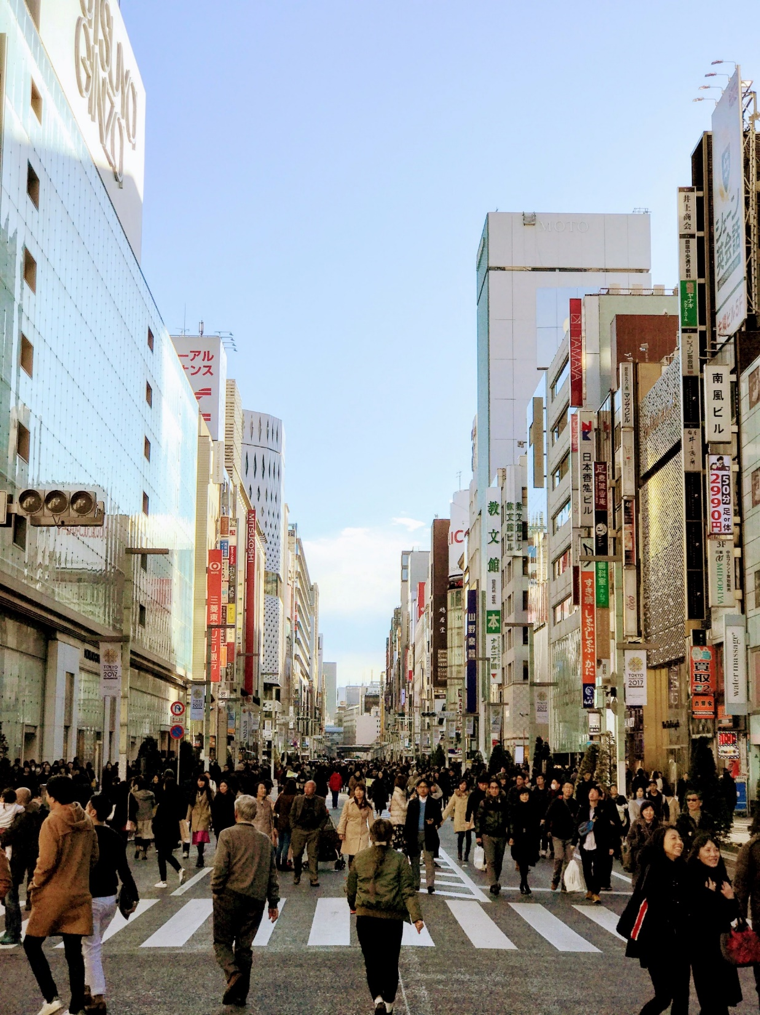
Who is Most Affected?
Notes:
Using 2015-2017 Washington Behavioral Risk Factor Surveillance System (BRFSS) data, researchers were able to identify populations of cannabis users who are more likely to use concentrated forms of cannabis by dabbing, eating, or vaping. We examined socio-demographic differences in specific modes of cannabis administration among adults who used cannabis in the past 30 days.

Slide 28
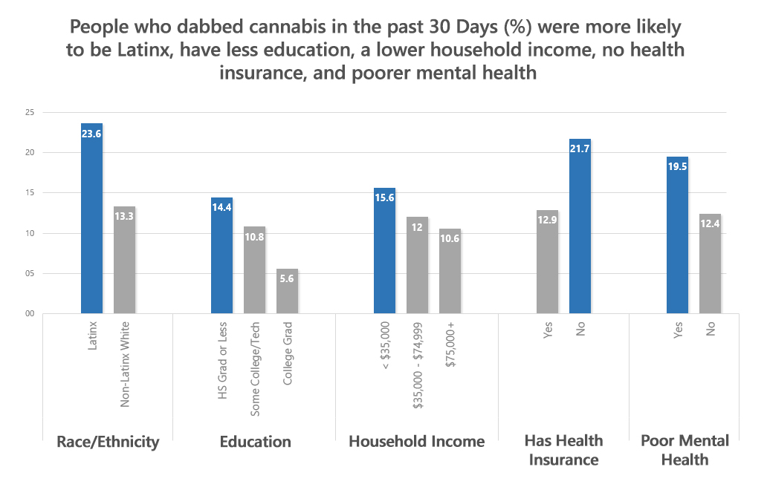
Who is Most Affected?
Caislin Firth, PhD, University of Washington
Data Source: 2015-2017 WA Department of Health, Behavioral Risk Factor Surveillance System (BRFSS)
Notes:
People who report low socio-economic status, being of Latinx descent, and poor mental health are more likely do dab in Washington. Adults with a high school diploma or less and low income (below $35,000 annual household income) were more likely to use cannabis and report dabbing, a mode of consumption that implies a large intake of highly potent cannabis in one hit. Men and adults under the age of 35 also reported more cannabis use and were more likely to dab. In addition, adults without health insurance and those who suffered from poor mental health (as defined by at least 14 poor mental health days in the past month) were more likely to use cannabis and dab. Unlike previous population groups who used more cannabis and dabbed, Latinx adults used less cannabis compared to white adults but were more likely to report dabbing in the past month. Lesbian, Gay, and Bisexual adults were three times as likely to report using cannabis than heterosexual adults, but LGB adults were no more likely to dab than heterosexual adults.
In contrast, vaping is associated with high income households. The highest use of vaping was among 35 to 44 year old adults, adults with college degrees, and households that made over $75,000. Similarly, preferences for using edibles were highest among college graduates. There were no other population group differences in edible use.

Slide 29
High potency cannabis disproportionally affects
marginalized and/or vulnerable populations
Notes:
Take Away: High potency cannabis extracts are increasing in popularity and segments of the population who are more likely to use cannabis tend to also report more dabbing. In Washington, marginalized communities and vulnerable individuals are more likely to use high-potency concentrates through dabbing. There are two notable exceptions: Lesbian, Gay, and Bisexual adults are 3 times as likely to use cannabis but do not prefer dabbing any more than heterosexual adults do, and Latinx adults are less likely to use cannabis but when they do, they prefer dabbing over non-Latinx, white adults.
Context: BRFSS surveys use well established methods of data collection from representative samples that enable individuals from diverse backgrounds to report their behaviors anonymously, allowing for fair public policy planning. While BRFSS data does not collect the exact concentration of cannabis products used, data on modes of consumption and types of products used are a valid – while not perfect – strategy to determine who is more likely to use cannabis in different ways.

Slide 30
Health Risks and Consequences—Take Home
THC Content in Cannabis Products Contributes to Adverse Health Effects in a Dose-Response Manner
Increased risk imposed is particularly concerning for young users and those with certain pre-existing mental health conditions.
Harms are likely to disproportionately affect marginalized populations (low income, minorities) who choose high potency products because of their lower costs, ease and discrete nature of use, glamorization of its use through social media and advertising, and perception of safety.
Notes:
This group of researchers signed a consensus statement with these take home messages . . .

Slide 31
Next Steps: Research Agenda
Epidemiology and consumers’ motives
Measurement
Driving
Adolescents
Reducing research constraints imposed by federal policies
Notes:
To further our understanding on the impact of high-THC content cannabis products, more research is needed.
A non-exhaustive agenda of research topics include:
Epidemiology and consumers’ motives
• Understand motivations and factors involved in the choice of using high potency concentrated cannabis products over lower potency products.
• Understand how advertisement and marketing influence product use, and identify solutions to educate users and reduce unintended harms associated with using concentrated cannabis products.
Measurement
• Establish standardized units of THC potency and of THC use frequency that will enable thorough comparison of results.
• Establish good measures for "dose" of cannabis products, including so that eventually caps might be established for potency
• Better understanding of what "potency" means (THC, CBD, a ratio of the two, something else)
• Define thresholds for problem use (similar to alcohol thresholds for "heavy" or "binge" drinking that are risk factors for acute effects and dependence, but which are different than dependence - maybe these would vary by population group such as by age, gender, and by THC level and/or product type)
• More precise laboratory measurements of THC (and other content) in manufactured products, and better protocols for standardizing and certifying/monitoring lab performance to measures potency
Driving
• Further understanding on THC concentration impact on driving performance. Driving simulator and closed-course options present safe pathways for this research, including both regular and occasional cannabis users to better document any variation in concentration effects.
• Observational research must expand beyond the analysis of officer initiated DUI arrests and fatal crashes to include non-fatal crashes, to provide a broader representation of cannabis-involved incidents.
Adolescents
• Study the impact of the dose-dependent use of THC by common modes of delivery (e.g. smoking, vaping and edibles) and common regimens (e.g. weekly, daily, multiple time per day) on adolescent brain development and in both human and preclinical model systems (e.g. rodents and primates) in both sexes.
• Implement harm reduction strategies to limit the availability of high-potency cannabis and study if and how these strategies reduce the number of individuals who develop CUD and the risk of mental health disorders.
Reduce research constraints imposed by federal policies: We urgently need research on market products. Reducing restrictions imposed by the DEA would allow us to do higher quality research on market products.

Slide 32
Cannabis Concentration and Health Risks
A report for the Washington State Prevention Research Subcommittee (PRSC)
Joint University of Washington and Washington State University Workgroup:
Beatriz Carlini (Chair) Celestina Barbosa-Leiker Carrie Cuttler Julia Dilley Caislin Firth | Kevin Haggerty Jason Kilmer Michael McDonell Nephi Stella Denise Walker Dale Willits
With:
Sara Broschart, WA State Liquor and Cannabis Board Trecia Ehrlich, WA State Liquor and Cannabis Board Kristen Haley, WA State Department of Health Christine Steele, WA State Health Care Authority, Division of Behavioral Health & Recovery Liz Wilhelm, Prevention WINS
Beatriz Carlini, Caislin Firth, and Sharon Garrett (editors)
Erinn McGraw and Meg Brunner (graphic design)
University of Washington, Alcohol & Drug Abuse Institute

Slide 33
Questions
Notes:
Add Research Agenda here

