Slide 1
Willow Brook Elementary School

Slide 2
About WBES:
Title I school since 2008
Built in 1948
Current Enrollment: 383 (185 Female, 198 male)
Economically Disadvantaged: 40% (154 students)
ELL: 7 % (25 students)
SWD: 20 % (75 students)
African American: 30 % (113 students)
Hispanic: 11 % (43 students)
Asian/ Native American/ Pacific Islander: 1 % (5 students)

Slide 3
Everybody Plays a Role

Slide 4
About WBES:
STAFFING
20 Classroom teachers
4 Special Education teachers
1.2 Speech/ Language Pathologists
1 ELL teacher
2 Reading Specialists
0.6 Math Specialist
1 Art teacher
1 P.E. teacher
1 Music teacher
1 Library/ Media Specialist
5 Special Education TAs
2.5 Paraprofessionals
7.00 Regular TAs

Slide 5
Title I Funding for FY 2022: $136,000
2.25 Instructional Assistants
0.2 Math Coordinator/ Coach
Teacher Stipends (extended learning)
Staff Development/ travel
Instructional Supplies
Transportation for extended learning
Supplies/ Materials for Parent Engagement Events

Slide 6
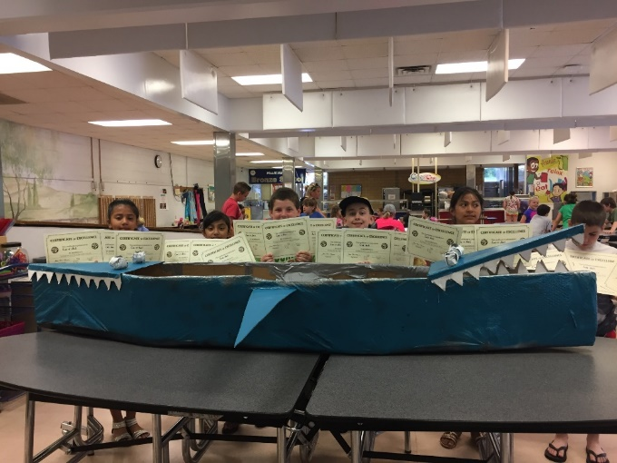
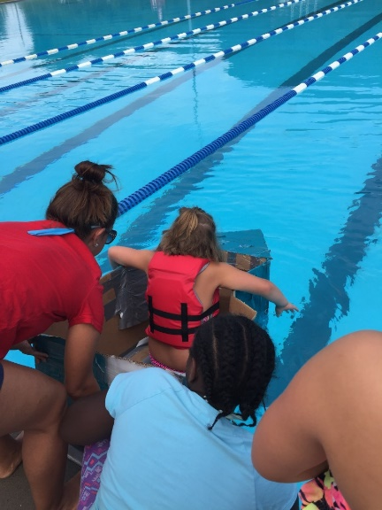
About WBES
Community Eligibility Program/ Food For Kids Program
21st CCLC Before and Afterschool programming
Safety Patrol
Student Senate
WBES Broadcasting Crew

Slide 7
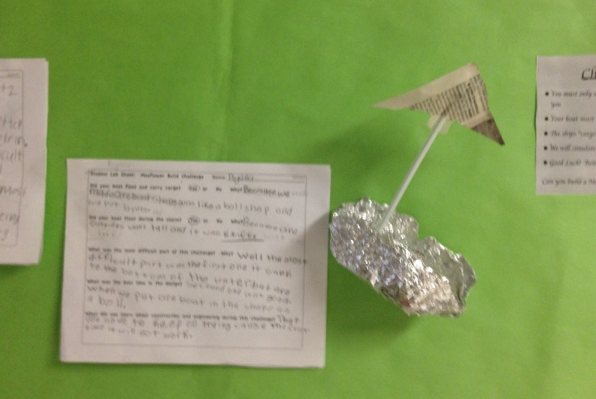
Cognia STEM-certified

Slide 8
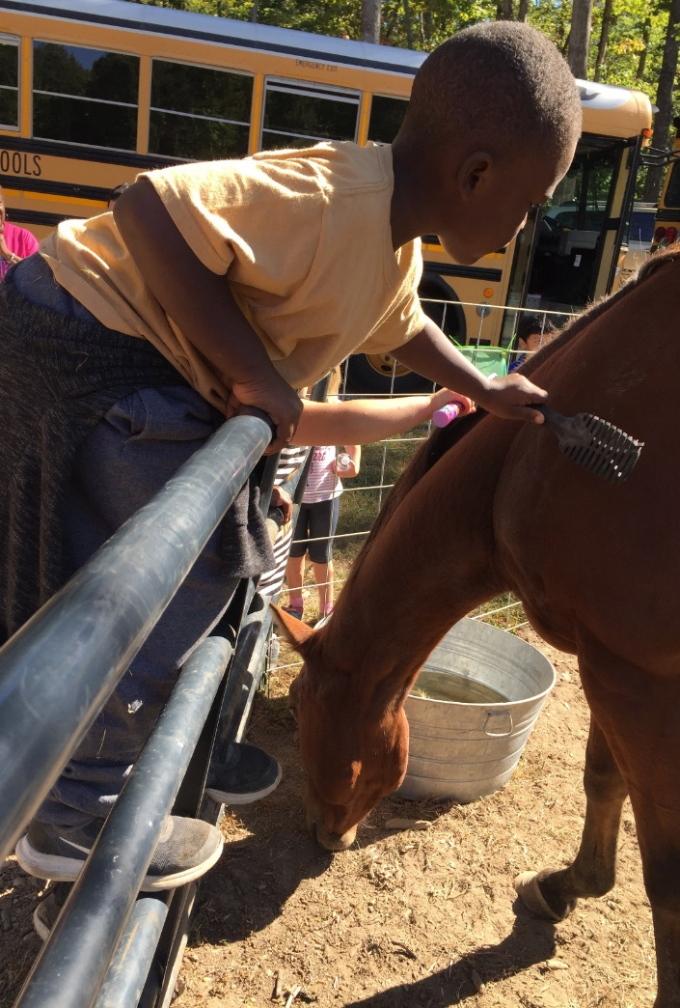
About WBES:
Readers and Leaders
Intersession
Learning Loss Summer Camp and After School Tutoring
Kindergarten Readiness
Positive Behavior Intervention and Support (PBIS)
Great Kindness Challenge

Slide 9
Community Partners
Atkins Nuclear
ORNL
CNS Y-12
Children’s Museum of Oak Ridge
First Presbyterian Church
First United Methodist Church
The Ridge Church
Exxon
Willow Brook PTO
Oak Ridge Breakfast Rotary Club
Rotary Club of Oak Ridge (Noon)
McNabb Center

