Slide 1
Kicking Off Your Season
Provided by MSHSAA, the NWCA, & FloSports

Slide 2
IMPORTANT DATES IN THE MSHSAA SEASON
First assessment date: Girls – October 30, Boys – November 6
Last assessment date: January 13, 2024 (Unless the wrestler qualifies for and is granted a Weight Certification Exception. The Weight Certification Exception Form can be found on the MSHSAA website on the wrestling page)
Minimum wrestling weight deadline: January 13, 2024
Scratch weight deadline : January 13, 2024
Growth allowance date: January 14, 2024
District Tournament : Girls – February 9-10,
Boys – February 16-17

Slide 3
KICKING OFF YOUR SEASON: YOUR ROSTER
-You will be sent your login credentials directly from TrackWrestling. Login credentials are emailed to team administrators and coaches as follows:
Girls – Friday, October 27, 2023
Boys – Friday, November 3, 2023
-Always start with importing your roster from last season
-Video Link: How to Import Your Roster from last season
-Then add new additions
-Video Link: Adding New Wrestlers to your Roster
Your first task is to import & add new wrestlers to your team roster.

Slide 4
KICKING OFF YOUR SEASON: ASSESSMENTS
Assessor Practice Transactions: How to Video
Approving or Denying Weight Assessments: How to Video
Viewing a wrestler’s Alpha Master: How to Video
MSHSAA RULES ON ADMINISTERING ASSESSMENTS:https://admin.mshsaa.org/resources/Activities/Wrestling/Weight%20Management%20Program%20Manual.pdf

Slide 5
KICKING OFF YOUR SEASON: YOUR SCHEDULE
To Add a Dual Meet: How to Video
To Add an Individual Tournament: How to Video
To Add a Multi-Dual Event: How to Video
-Please note: Once you add a team to an event, it shows up on their schedule to “accept.” You can accept events versus adding a second one to avoid duplicate events and results.
MSHSAA RULE – A chedules must be completed by [I

Slide 6
KICKING OFF YOUR SEASON: WEIGH-INS
Creating a Weigh-In Sheet: How to Video
Entering and Committing Weights: How to Video
MSHSAA RULE on actual weight entry: Wrestling Manual Section 2, Letter I
MANDATORY ACTUAL WEIGHT ENTRY: It is mandatory that the “actual weight” of each wrestler for every weigh-in be entered into the TrackWrestling OPC within 48 hours of the completion of a weigh-in. The setting in TrackWrestling will only permit the weigh-ins from 2 contests on a team’s schedule to remain open before blocking the printing of the next weigh-in form.

Slide 7
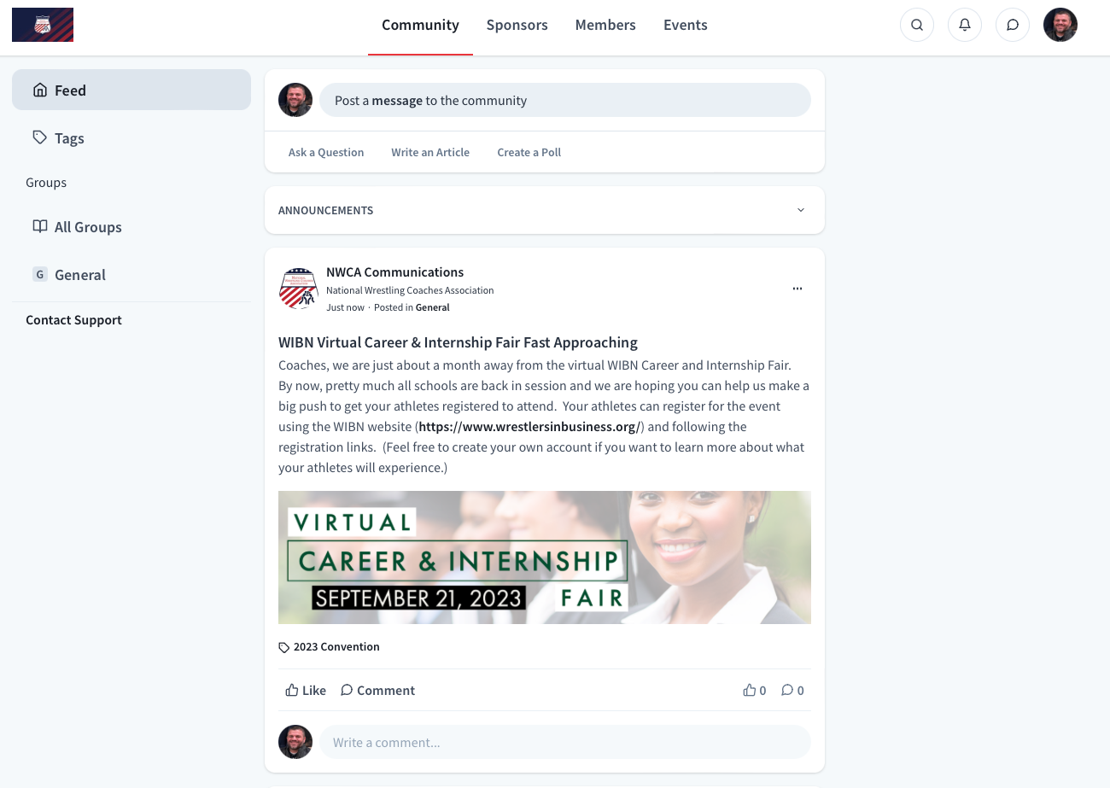
KICKING OFF YOUR SEASON: YOUR BENEFITS
-LIVE Dual Meet scoring is FREE on TrackWrestling: How to Video -All OPC Subscribers are also NWCA Members! -Please go to NWCAonline.com, navigate to MEMBERSHIP in the top right and explore our members-only portal.
GOOD LUCK this season!

