Slide 1
$25 Billion For Public Transit for COVID-19:
An Update From APTA
March 25, 2020

Slide 2
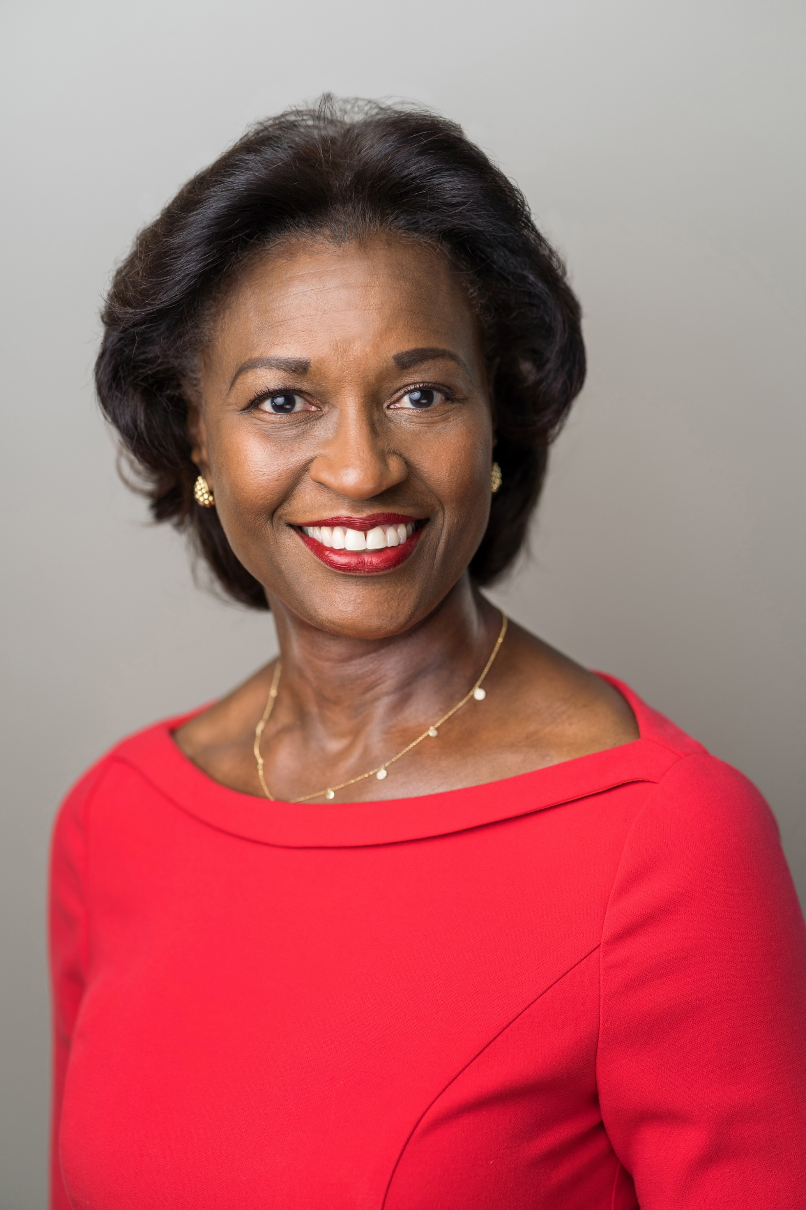
Welcome Remarks
Nuria Fernandez
Chair, APTA
General Manager and CEO
Santa Clara Valley Transportation Authority
San Jose, CA

Slide 3
Introduction
Paul P. Skoutelas
President and CEO
American Public
Transportation Association

Slide 4
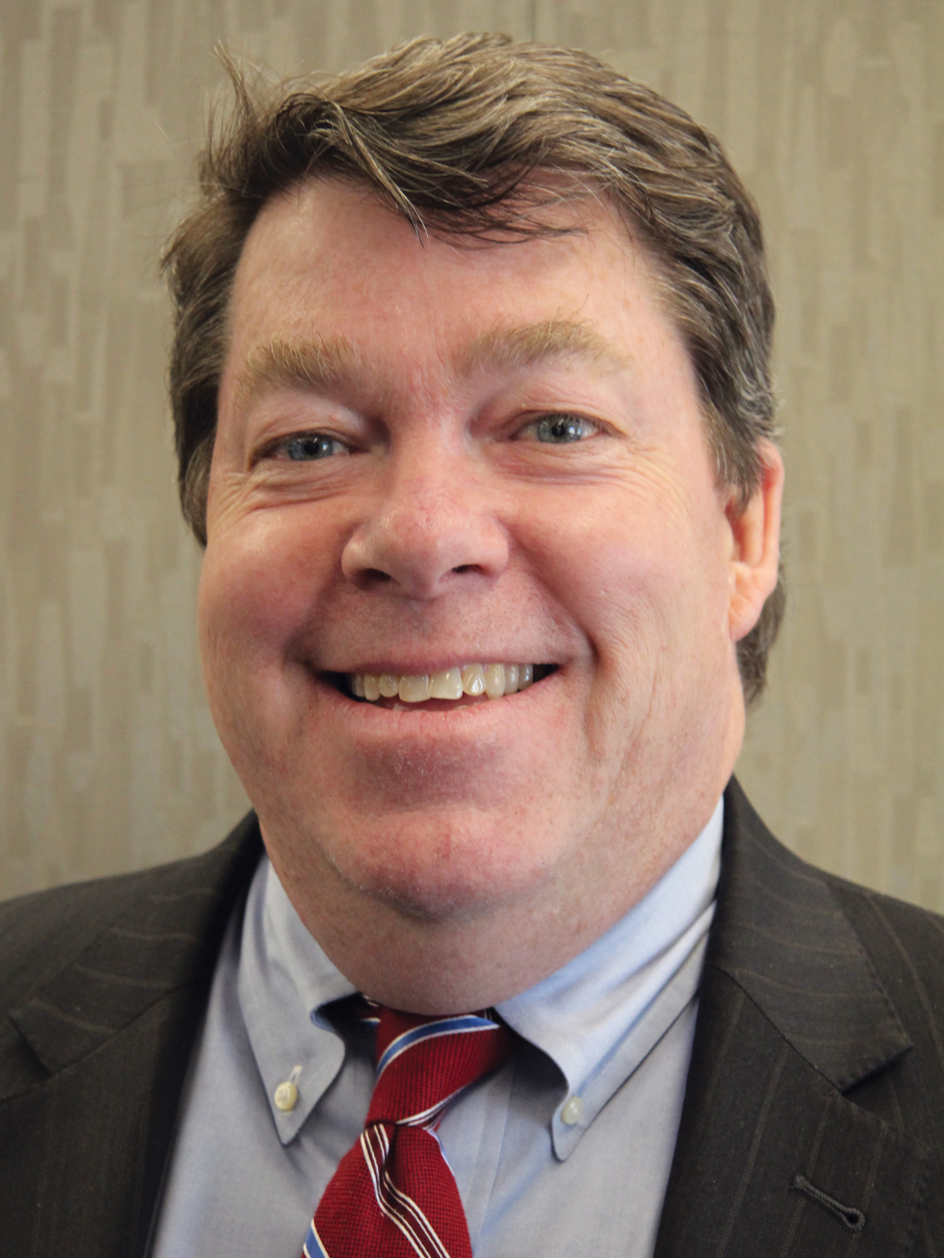
Speaker
Ward McCarragher
Vice President
Government Affairs
and Advocacy
APTA

Slide 5
Public Transit Funding Comparison

Slide 6
Distribution
Distributes Transit Funds Proportionately Among 4 Programs:
5307 Urbanized Area Formula
5311 Rural Formula
5337 State of Good Repair Formula
5340 Growing and High-Density States Formula

Slide 7
Eligible Uses
Funds to Prevent, Prepare for, and Respond to COVID-19
Operating Expenses, Beginning on January 20, 2020:
Operating Costs to Maintain Service
Lost Revenue Due to Coronavirus
Purchase of Personal Protective Equipment
Paying Administrative Leave of Operations Personnel
Federal Share is 100 percent

Slide 8
Other Provisions
FTA Must Apportion Funds within 7 Days of Enactment
FTA Prohibited from Waiving Prevailing Wage and Transit Labor Standards (49 U.S.C. 5333)
Operating Expenses—Not Included in State Plans and Transportation Improvement Programs (TIPs)

Slide 9
Amtrak Funding
Provides $1 billion for Amtrak grants for COVID-19 Response $492 million for the Northeast Corridor grants
$526 million for the National Network grants
State-Supported Routes: States Pay 80 percent (Sets Aside $239 million for this Purpose)

Slide 10
Small Business Loan Program
$350 billion in Loans and Loan Guarantees to Protect Workers and Businesses
Available to Employers who Maintain Payroll
Loans for Payroll Costs, Interest on Mortgage/Loan Obligations, Rent, etc.
Applies Beginning February 15, 2020 to Assist Furloughed Workers

Slide 11
Today’s Speakers
Nuria Fernandez
Paul P. Skoutelas
Ward McCarragher

Slide 12
Have Questions?
Please send your questions to coronavirusquestions@apta.com
We will answer once there are more specifics on the legislation.

Slide 13
Upcoming Event
The Federal Transit Administration is inviting industry stakeholders to join the leadership from the U.S. Department of Transportation for a teleconference this Thursday, March 26 at 3:00 p.m. (Eastern).
The briefing will provide information and answer questions on the Administration’s response to COVID-19.
Register at: https://ems8.intellor.com?do=register&t=1&p=823551, or on APTA’s Coronavirus response page
PRE-REGISTRATION REQUIRED

Slide 14
$25 Billion For Public Transit for COVID-19:
An Update From APTA
March 25, 2020

